Slide 1
Economics and Philosophy
Behavioural economics
Rulof Burger 8 Sept 2021

Slide 2
Outline for lecture
Classical economics vs. behavioural economics
Dual-process model of cognition
Trolley problem
Model of revealed preference vs behavioural approach
Application: hyperbolic discounting model

Slide 3
Classical economics
Economics is a social science that studies market forces and how people respond to such forces
Classical economic theories premised on notion that people behave rationally
They have (well-behaved) preferences
They process all available information appropriately
They make decisions that maximise expected welfare given constraints
These assumptions can produce very powerful and insightful models that help us understand, predict and influence human behaviour
However, such models assume that people have unlimited time and computing ability when making decisions
Notes:
Economics is a social science, like anthropology, political science and sociology; primarily interested in human behaviour.
Essence: figuring out what people care about, and what they are trying to achieve when they make decisions helps you understand, predict and influence their behaviour
Example: Economics of crime show that understanding what potential criminals are trying to achieve can: 1) help understand crime patterns (across time and space), 2) provide policy levers to curb criminal activity in most cost-effective way

Slide 4
Behavioural economics
In reality, some decisions are made when individuals are impatient, angry, distracted, hungry, drunk, etc.
Classical economics have traditionally viewed such psychological “quirks” as random errors that:
cancel out in large groups of people
disappear as people and society learn from their mistakes
are ultimately not of first order importance
However, since 1970s persuasively demonstrated that some of these errors are systematically biased
Insights from psychology that explain such “errors” can be crucial to understanding important aspects of human behaviour, and may help design policies to improve welfare
Birth of new field, known as Behavioural Economics
Studies joint effect of economic and psychological factors on human decisions
More appropriate name would have been Psychology and Economics
Notes:
BE already awarded 4 Nobel Prizes.
BE a bad name because all of economics is about behaviour
Matthew Rabin: BE suggests we only care about behaviour and not welfare, which is false

Slide 5
Behavioural economics
Three classes of deviations from prototypical model of rational agent
Non-standard preferences
Non-standard beliefs
Non-standard decision-making
Notes:
This follows taxonomy of Rabin (2002) and DellaVigna (2009)

Slide 6
Non-standard preferences
One set of explanations for behavioural anomalies is that individual preferences may deviate from what is commonly assumed:
When costs and benefits of decision accrues over time, individuals may have present-biased preferences
Relatively impatient when trading off current and near-term future utility, but patient when trading off near and far-term future utility
More about this later
They may also reveal reference dependence
Evaluating outcomes relative to some reference point
E.g. an unemployed person rejecting a good wage offer, because it is lower than the wage received at their previous job
Individual utility may reveal social preferences
Having a utility function that includes altruism, inequality aversion, fairness and reciprocity
Notes:
Hyperbolic discounting = people make decisions that they regret for immediate gratification which violates their LR preferences. Not the same as being impatient
Arbitrary reference points determine how we feel about things: reject wage offers lower than previous wages (so high wage in first job may be a curse); initially happy about 10% wage increase, until you learn that colleague received 12% increase.
Fairness: Thaler’s podcast story about someone cutting in line

Slide 7
Non-standard beliefs
A second set of deviations occur because people form beliefs about future utility and states of the world that deviates from rational expectations
People tend to:
have misplaced confidence in precision of beliefs (overconfidence);
overestimate own performance (particularly relative to others);
not anticipate predictable changes in their preferences (projection bias);
be too hasty in generalising from a small sample (law of small numbers);
excessively update beliefs based on personal experiences (experience effects);
have biased expectation (wishful thinking or defensive pessimism)
Also possible that beliefs may directly affect utility (belief-based preferences)
Notes:
Wishful thinking example: people who know that genetically they have 50% of having Huntingdon’s disease appear to (consciously or subconsciously) manipulate this belief to 0%.
Over-estimating own performance seems to be a particularly male trait
Projection bias includes an:
under-appreciation of habit formation = temporarily increase consumption - e.g. use an expensive coffee maker - and then surprised by how difficult it is to scale back down
hedonic adaptation = thinking that winning the lottery will make you eternally happy, but then quickly growing accustomed with your new lifestyle
intrapersonal empathy gap = under-estimate effect of temporary visceral state on decisions (overshopping when hungry, buying winter clothes when cold, underpacking for cold climate when hot)
Law of small samples include the gambler's fallacy, which is the mistaken belief that if something happens more frequently than normal during some period, it will happen less frequently in the future

Slide 8
Non-standard decision-making
Decision making sometimes deviates from utility maximisation, such as when:
people ignore choices that do not come to mind when making a decision (limited attention effect);
decisions are affected by the inclusion of irrelevant alternatives (menu effect);
people mentally partition expenses into different accounts in a way that affects decisions (mental accounting);
decisions are affected by advertising, promotions or political campaigns beyond the effect of such campaigns on information or prices (persuasion);
decisions are affected by emotions such as regret, envy or fear;
maximising “decision utility” is not the same as maximising happiness, life satisfaction or “experienced utility”
Notes:
Limited attention particularly severe for those living in poverty
Menu effect example: real estate agent who keeps bad property on portfolio so other properties will seem more attractive
Mental accounting: losing movie ticket makes you less inclined to still attend movie than losing equal amount of money (from general rather than entertainment account)
Decision utility: make decisions based on maximising career earnings, while underweighting aspects that provide life satisfaction (e.g. holidays with family)

Slide 9
Dual-process model of cognition
Many contemporary models of cognition conceive of mind as composed of two different sets of processes
Idea has many intellectual precursors: Plato, Freud, Adam Smith
More recently, social and cognitive psychologists have conceptualised the human brain as if functioning as two specialised processes
Kahneman (2011) popularised labels of System 1 and System 2
Neurological studies are confirming that these two processes occur in different parts of the brain
Notes:
Plato’s Charioteer anology: Charioteer driving a chariot pulled by two winged horses: "one of the horses is noble and of noble breed, but the other quite the opposite in breed and character. Therefore in our case the driving is necessarily difficult and troublesome.“ The Charioteer represents intellect, reason, or the part of the soul that must guide the soul to truth; one horse represents rational or moral impulse or the positive part of passionate nature; while the other represents the soul's irrational passions, appetites, or concupiscent nature. The Charioteer directs the entire chariot/soul, trying to stop the horses from going different ways, and to proceed towards enlightenment.
Freud’s structural model of the psyche: the id is the set of uncoordinated instinctual trends; the super-ego plays the critical and moralizing role; and the ego is the organized, realistic part that mediates between the desires of the id and the super-ego.
Adam Smith referred to struggle between our “passions” and “impartial spectator”

Slide 10

Two system thinking
24 x 17 = ?
Notes:
Picture = people instinctively notice that face is mad. Maybe you even anticipate what he will say and how he will sound
24 x 17 = 408.
When engaging system 2 pupils dilate, heart rate increases and you burn energy

Slide 11
System 1 and System 2
System 1 is fast, instinctual, emotional and unavailable for conscious introspection
It works automatically, with no or little effort or conscious control
Essential for recognising safe foods, avoiding dangerous animals, and behaving appropriately in social situations
System 2 is slower, deliberate and logical
It allocates attention and energy to certain cognitive activities, such as complicated calculations
Activating it dilates the pupils, increase heart rate and burns energy
In most cases these two systems function together efficiently
Problematic when some decisions are made by inappropriate system
Notes:
Examples of migrations: Chess master perceives strengths / weaknesses of chess positions instantly; pattern recognition has replaced effortful serial processing; Prolonged cultural exposure eventually produces a facility for social judgements, i.e. recognise personality descriptions as representative of certain occupation

Slide 12
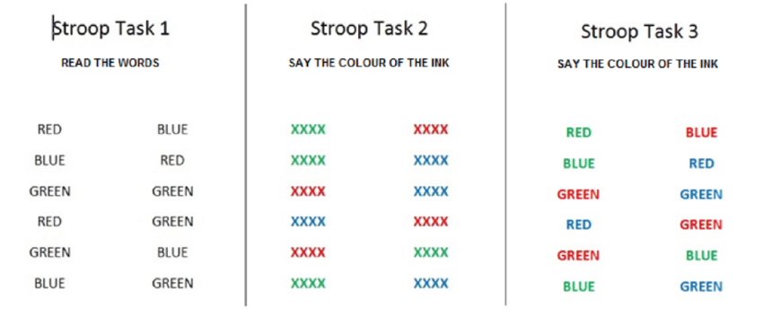
Notes:
Although mistakes are rare, the third Stroop task requires more cognitive effort and takes longer than other tasks

Slide 13
Two system thinking
Stroop task 3 illustrates this two-system structure:
Word is automatically read while inspecting its colour, and this happens more quickly than colour is identified
This activates response which needs to be actively suppressed
Errors are rare, but conflict produces delays and hesitations
Successful suppression is effortful and its efficacy is reduced by stress and distraction

Slide 14
Neuroeconomics
Neurological studies increasingly allow us to link behaviour to brain activities
Dual-process cognitive model seems to be supported by fMRI scans that show two different parts of the brain working when considering problems in which systems 1 and 2 are in conflict:
Dopamine rewards system (DRS) = System 1
Pre-frontal cortex (PFC) = System 2

Slide 15
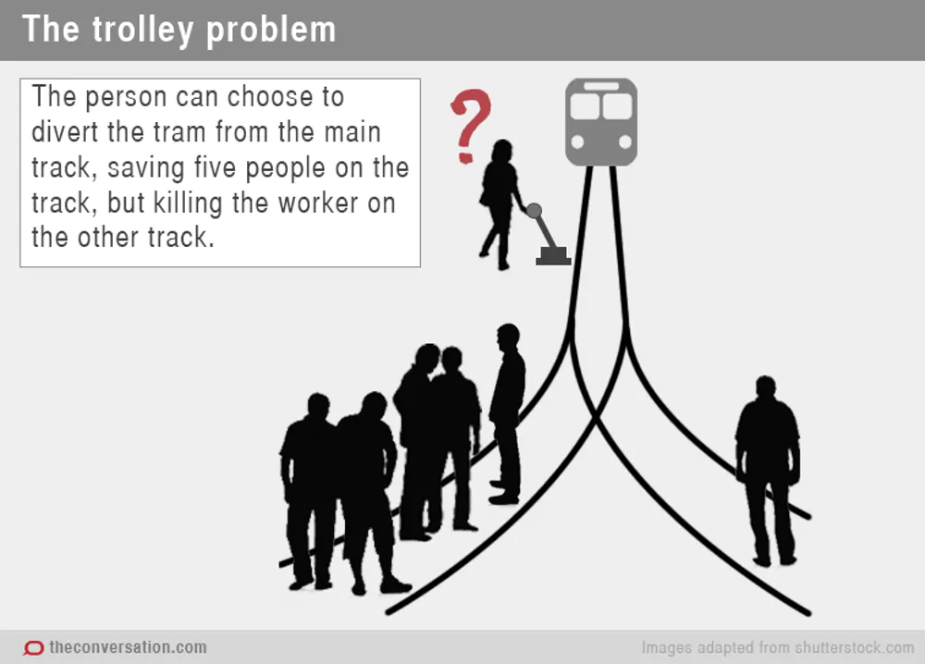
Notes:
A trolley is heading down a track on which there are five railroad workers, who cannot get off the track. They will be killed if nothing is done.
Switch scenario: You are an operator who can flip a switch to divert the trolley from its current track to a different track on which a single person is walking.
NB: The question is not what you WOULD do but what you SHOULD do.

Slide 16
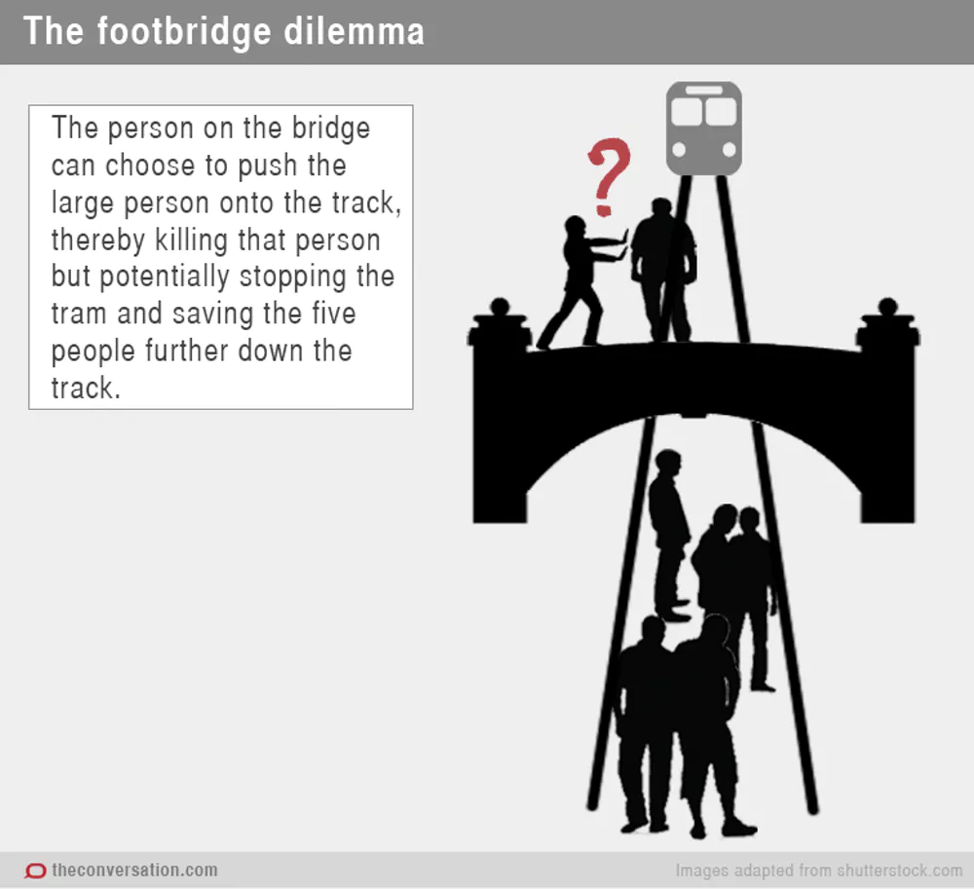

Slide 17
Trolley dilemma
Puzzle:
Most people think it is ethically justifiable to flip the switch (killing 1 person to save 5 lives), but not to push the large person off the footbridge
Philosophers and ethicist have proposed various rationalisations of different evaluations of “actuarially” identical scenarios
Neuroscientists found considering the different scenarios activated different parts of brain:
Switch scenario (which required inflicting harm at a distance) activated the PFC, whereas Footbridge scenario (which required nearby harm) activated DRS
Notes:
Incidental vs instrumental nature of death of single individual. But slight variation of switch scenario in which single death is instrumental is still deemed justifiable.
Neurologists have used brain imaging to “solve” trolley dilemma: pulling a lever effects violence far away (which until recently was impossible, and hence we have no evolutionary distaste for it), whereas pushing someone off a footbridge entails violence in less than a stone’s throw away (a distaste for which would have assisted our species in constructing stable communities and an evolutionary advantage)

Slide 18
Trolley dilemma
Cohen (2005) hypothesises that emotional aversion to harming other humans evolved to allow early humans to aggregate more effectively into stable social structures
However, this adaptation arose during time when scope for aggression was limited to a stone’s throw (literally); no evolutionary pressure to develop emotional aversion to harming others at greater distances
This (and other similar issues) important for policy researchers:
Social policies often meant to protect us from emotions that once served us well but can now interfere with our welfare
Notes:
Other examples: Rejecting low offers in ultimatum game corresponds to more activity in DRS and less in PFC
Same for choosing small immediate rewards over large delayed reward
Also activity in PFC appears to be relevant for effectiveness of placebos

Slide 19
Model of revealed preference
Dominant model of choice in microeconomics is revealed preference
Supposes that choices reveal both normative preferences and the positive model of behaviour
Essentially: whatever you choose is what maximises your happiness
Behavioural economic models often assume that utility / happiness exists separately from observed choice

Slide 20
Model of revealed preference
Suppose you observe me reveal the following behaviour:
When the weather forecasts predicts rain for the next morning, I set my alarm clock for 6:30am
Otherwise, I set my alarm clock for 5:30am so I can go for a jog
But when the alarm wakes me up, I press snooze and sleep until 6:30am
My self-reported preference ranking (at night) are as follows:
Wake up at 5:30am and go for a jog (unless its raining)
Wake up at 6:30am (too late to go for a jog)
Wake up at 5:30am and then snooze and fail to go for a jog

Slide 21
Model of revealed preference
Revealed preference approach:
Ignore my self-reported preferences
Assume that I prefer to set the alarm for 6:30am when it’s rainy
Assume that I prefer to set the alarm for 5:30 and lie in bed until 6:30 otherwise
Assume that I prefer never to jog
My actions are therefore in line with my preferences, and I am maximising my welfare
Model wouldn’t make good out-of-sample predictions: what would I do on a sunny day when I am injured?

Slide 22
Behavioural economic model
Alternative approach: develop a model in which I prefer to go to the gym tomorrow (in line with my stated preferences) but prefer not to jog today
Make assumptions that map positive model to normative preferences
Alternative approach produces model that is relatively parsimonious, is congruent with my own explanation of what is going on, and makes accurate and precise out-of-sample predictions
Example: hyperbolic discounting model of intertemporal choice

Slide 23
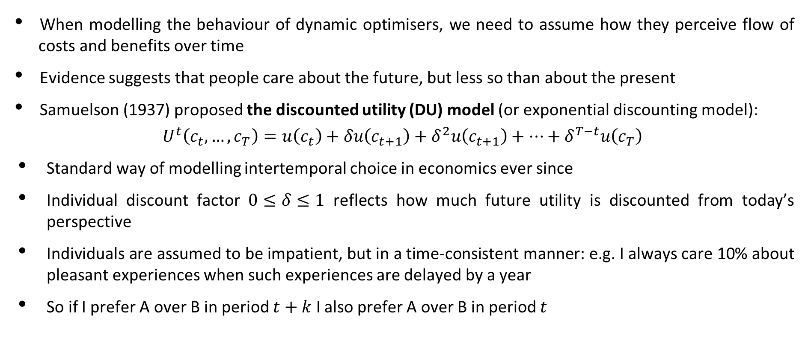
Intertemporal choice
When modelling the behaviour of dynamic optimisers, we need to assume how they perceive flow of costs and benefits over time
Evidence suggests that people care about the future, but less so than about the present
Samuelson (1937) proposed the discounted utility (DU) model (or exponential discounting model):
$$U^{t}\left(c_{t},…,c_{T}\right)=u\left(c_{t}\right)+δu\left(c_{t+1}\right)+δ^{2}u\left(c_{t+1}\right)+…+δ^{T−t}u\left(c_{T}\right)$$
Standard way of modelling intertemporal choice in economics ever since
Individual discount factor $0≤δ≤1$ reflects how much future utility is discounted from today’s perspective
Individuals are assumed to be impatient, but in a time-consistent manner: e.g. I always care 10% about pleasant experiences when such experiences are delayed by a year
So if I prefer A over B in period $t+k$ I also prefer A over B in period $t$

Slide 24
Time inconsistency
Read and Van Leeuwen (1998) asked office workers to choose between a healthy snack (fruit) and an unhealthy snack (chocolate bar) to be delivered a week later:
74% opted for the healthy snack
When they returned the next week, the experimenters allowed them to change their minds:
Only 30% chose the healthy snack
Read, Loewenstein & Kalyanaraman (1999) asked individuals to choose between highbrow movie (e.g. Schindler's List) or low-brow movie (e.g. Four Weddings and a Funeral) for today and next week:
When choosing for next week: High-brow movie (63%) or Low-brow movie (37%)
When choosing for today: High-brow movie (34%) or Low-brow movie (66%)
These studies demonstrate that people commonly reverse their preferences for no apparent reason other than time passing, which should not happen if everyone was an exponential discounter

Slide 25
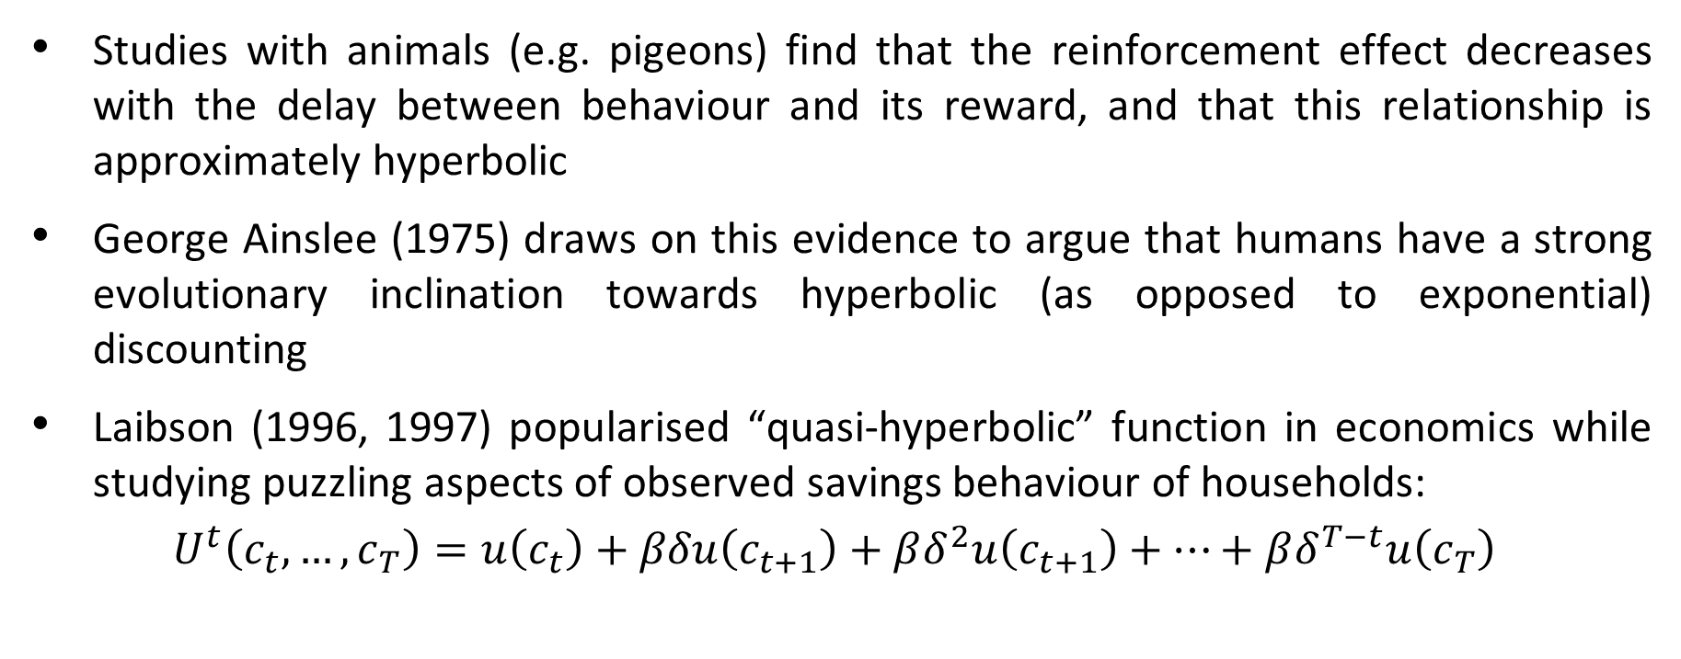
History of the hyperbolic discounting model
Studies with animals (e.g. pigeons) find that the reinforcement effect decreases with the delay between behaviour and its reward, and that this relationship is approximately hyperbolic
George Ainslee (1975) draws on this evidence to argue that humans have a strong evolutionary inclination towards hyperbolic (as opposed to exponential) discounting
Laibson (1996, 1997) popularised “quasi-hyperbolic” function in economics while studying puzzling aspects of observed savings behaviour of households:
$$U^{t}\left(c_{t},…,c_{T}\right)=u\left(c_{t}\right)+βδu\left(c_{t+1}\right)+βδ^{2}u\left(c_{t+1}\right)+…+βδ^{T−t}u\left(c_{T}\right)$$

Slide 26
Hyperbolic discounting: predictions
Friction between short-run impulse and long-run desire for self-control
People will over-indulge in vice goods (with small immediate rewards and large delayed costs) and under-consume virtue goods (small immediate costs and large delayed rewards) relative to their own long-run preferences
Individuals will engage in welfare reducing procrastination (perpetual delay of important tasks that are immediately unpleasant), especially if naïve about future time inconsistency
Small increase in immediate benefit or reduction in immediate cost can induce large change in behaviour
Individuals who are sophisticated about future time inconsistency may opt to use costly commitment devices to lock in future decisions
Change in choice architecture (e.g. changes in default choice if no active choice is made) can influence decision

Slide 27
Neuro-economic evidence
McClure et al. (2004) perform fMRI scans on subjects as they made a series of choices between monetary reward options that varied by delay to delivery
When considering two future options, regions of the lateral prefrontal cortex (used to exert self-control) and posterior parietal cortex (quantitative comparisons) were engaged
When considering immediately available rewards, parts of the dopamine reward system (positive emotions) were also engaged
Relative engagement of two systems were directly associated with subjects’ choices: greater relative fronto-parietal activity predicts choosing longer-term options
Some evidence that this relationship is causal:
Subjects are less patient when placed under cognitive load (which occupies prefrontal cortex)
Experimentally disrupting normal functioning of the lateral pre-frontal cortex causes choices to shift towards the sooner option
Notes:
Cognitive load = trying to remember sequence of numbers

Slide 28
Consumption of vice and virtue goods
Consider the example of buying a magazine that is fun to read but with no future benefits (e.g. Heat magazine as opposed to something like The Economist)
Model of hyperbolic discounting predicts that such magazines will have low demand via subscription but high demand at check-out line
Oster and Morton (2006) find evidence that publishers take advantage of this time inconsistency when setting prices
Magazines that are deemed to yield instant gratification with little future value have significantly lower subscription to newsstand price ratios, but are still sold disproportionately at newsstands
This also suggests that people’s decisions to buy Heat magazine may not reflect their (long-term) welfare-maximising choice

Slide 29
Procrastination
Decisions of hyperbolic discounters sometimes modelled as game theoretic interaction between long-term self and current decision maker
Example:
I set the alarm today to go to the gym tomorrow morning at 6am
Tomorrow morning I decide to postpone exercise to the next day
When I again snooze my alarm…
If current decision maker naively believes that they will exert more self-control in future then harmful decision not to ever exercise is viewed as sequence of not very harmful postponement decisions
Cycle of procrastination can lead to perpetual postponement of unpleasant but important tasks
Inability to commit to future actions drives a wedge between our intention and our behaviour (referred to as an “intention-behaviour gap”)

Slide 30
Thornton (2008)
Procrastination can have detrimental welfare outcomes
Thornton (2008) performed experiment on subjects in rural Malawi who were tested for HIV and then had to choose whether to learn their status in the near future
Widely held view that large psychological or stigma-related cost is primary barrier to collecting HIV test results
Small monetary incentives should have little effect on behaviour
Alternative view: hyperbolic discounters are postponing the decision to learn results due to small immediate cost (anxiety, travel time to result centre) compared to larger but delayed benefit
Small incentives may matter, if they reduce immediate cost or increase immediate benefit
Remember: for hyperbolic discounters the choice that determines behaviour is not between learning status and not learning status, but whether or not to learn status today

Slide 31
Thornton (2008)
Monetary incentives and distance to HIV results centre were randomly assigned in order to test whether small but immediate incentives can help individuals overcome present bias
Results show that:
Without any incentive 34% of participants chose to learn their result
This share increases to above 60% when offering $0.2 and to nearly 90% when offering $2 (roughly the average local daily wage)
Living more than 1.5 kilometres from the centre reduced attendance by 6pp
Hyperbolic discounting provides most coherent explanation for results

Slide 32
Thornton (2008)

Slide 33
Thornton (2008)

Slide 34
Self-awareness
Naïve hyperbolic discounters are continually surprised by their procrastination, whereas sophisticated hyperbolic discounters anticipate such behaviour
With regards to exercise behaviour, this predicts that naïfs should join a gym and never exercise; sophisticates should know better and not join the gym in the first place
Data from health club membership in the US (DellaVigna & Malmendier 2006) suggest that many people are naïfs:
Average gym member who joins on yearly basis pays $75 per month and only visit 4 times per month
Average per-visit cost is $17, while the “pay-per-visit” cost is only $10
Can potentially investigate whether agent is “self-aware” by looking at whether voluntarily commits to dynamically optimal decision path

Slide 35
List of known commitment devices
Cutting up ones credit cards
Only taking a fixed amount of money along when heading out to a party
Buying junk food in small packages rather than in bulk
Not keeping alcohol in the house
Brushing one’s teeth earlier in the evening in order to avoid late night snacking
Drinking a lot of water before going to bed in order to make oneself get out of bed earlier
Leaving one’s laptop or papers at the office, so that home time is not spent working
Buying a long term gym membership rather than paying by the day

Slide 38
Retirement savings
Hyperbolic discounting may affect retirement savings
Choosing best plan and savings amount requires time and effort costs in the present, for future benefits
Hyperbolic discounters may enter cycle of procrastination and delay saving for retirement
Choi et al. (2006) survey US workers
Two-thirds of respondents felt that they were not saving enough
A third intended to increase their contribution
But none did in the next two months

Slide 39
Madrian & Shea (2001)
Madrian & Shea (2001) investigate the effect of changes in enrolment in 401(k) plan for a large US company:
Workers hired before change (OLD) were not enrolled in a plan by default
Workers hired after change (NEW) were automatically enrolled in a plan
Both groups of workers were free to change their plan, so only change is default choice
RQ: does the difference in default choice have an impact of savings rate?
High stakes natural field experiment with persuasive identification strategy

Slide 40
Madrian & Shea (2001)

Slide 41
Madrian & Shea (2001)
NEW workers hired after change have much higher participation rates than workers hired before
Even OLD workers who have worked in the company for several years
But most of these NEW workers also opted for the relatively low default contribution rate
It seems that most workers simply opt for default choice
Most coherent explanation: workers are naïve hyperbolic discounters and transaction costs to select and set up retirement plan is non-negligible

Slide 42
Policy implications
If people are sufficiently self-aware about own self-control problems, then provision of commitment devices may improve welfare
If people are naïve then decision-making environment that is more conducive to savings behaviour, e.g. automatic enrolment, with option to actively opt-out
Several studies have shown that such defaults can be remarkably effective in nudging workers towards retirement saving
This is called a nudge, and is in line with the libertarian paternalism approach to policy making: it does not preclude any choice (libertarian), but tries to change to choice architecture to promote a specific choice (paternalism)

